Slide 1
GWDAW 2010 - January 26, 2010 – Rome, Italy
Coherent Target Detection
in Heavy-Tailed
Compound-Gaussian Clutter:
Survey and New Results
Kevin J. Sangston
Atlanta, Georgia (GA)
jsangston@mac.com
Fulvio Gini, Maria S. Greco
Dept. of Ingegneria dell’Informazione
University of Pisa
Via G. Caruso 16, I-56122, Pisa, Italy
f.gini@iet.unipi.it, m.greco@iet.unipi.it

Slide 2
3
4
Coherent
Radar
Detection
Three
formulations
of the OD
Sub-optimum
Detectors
5
Radar
Clutter
Modelling
2
GLRT-LTD
and its
Performance
6
Introduction
1
Outline
of the
Talk
Concluding
Remarks
7
“Coherent Target Detection in Heavy-Tailed
Compound-Gaussian Clutter: Survey and New Results”

Slide 3
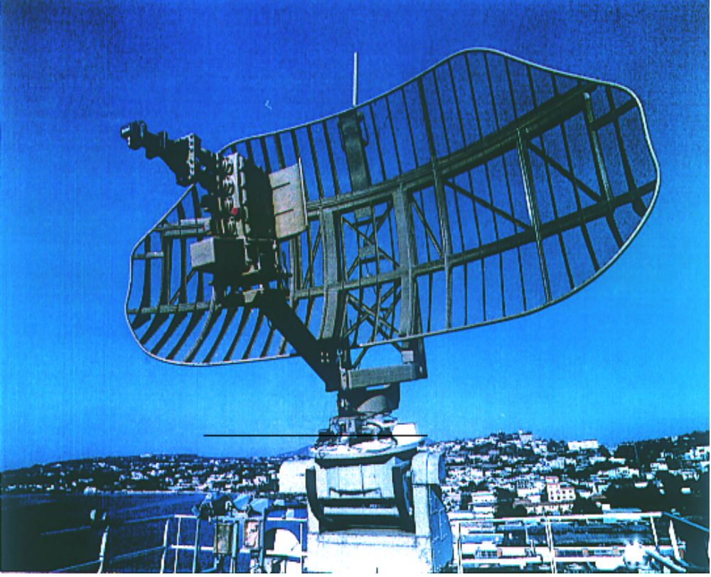
Introduction
Radar systems detect targets by
examining reflected energy,
or returns, from objects
Along with target echoes, returns come
from the sea surface, land masses,
buildings, rainstorms, and other sources
Much of this clutter is far stronger than
signals received from targets of interest
The main challenge to radar systems is
discriminating these weaker target
echoes from clutter
Coherent signal processing
techniques are used to this end
Courtesy of SELEX S.I.
The IEEE Standard Radar Definitions (Std 686-1990) defines coherent signal
processing as echo integration, filtering, or detection using the amplitude of the
received signals and its phase referred to that of a reference oscillator or to the
transmitted signal.
Key of the definition: use of phase information in the signal processing

Slide 4
Radar Clutter Modeling and the Detection Problem
The problem of coherent detection splits naturally into two fundamental sub-problems:
In the first sub-problem, a model must be formulated for the underlying disturbance (noise and/or clutter) from which the signals of interest are to be discriminated.
The solution of this problem must achieve a balance between the
faithful representation of the actual disturbance and the mathematical
tractability of the resulting model.
In the second sub-problem, a detection structure which minimizes the loss relative to the optimum detection structure, while at the same time being easy to implement, must be obtained.
The mathematical tractability of the disturbance model is a significant factor
in determining the ease of implementation of the resulting detection structure.
The formulation of the optimal detector depends on the model that is
utilized to describe the non-Gaussian statistics of the disturbance.

Slide 5



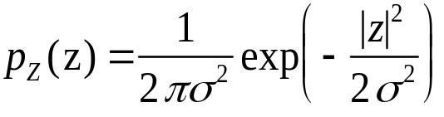
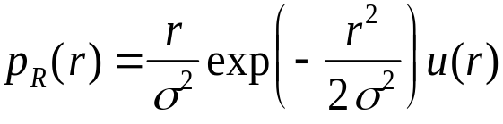
Radar clutter modeling
In early studies [Gol51], the resolution capabilities of radar systems were
relatively low, and the scattered return from clutter was thought to comprise
a large number of scatterers
From the Central Limit Theorem (CLT), researchers in the field were led to
conclude that the appropriate statistical model for clutter was the Gaussian
model for the I & Q components, i.e., the amplitude R is Rayleigh distributed

Slide 6
Radar clutter modeling
In the quest for better performance, the resolution capabilities of radar systems
have been improved
For detection performance, the belief originally was that a higher resolution
radar system would intercept less clutter than a lower resolution system,
thereby increasing detection performance
However, as resolution has increased, the clutter statistics have no longer
been observed to be Gaussian, and the detection performance has not
improved directly
The radar system is now plagued by target-like “spikes” that give rise to
non-Gaussian observations
These spikes are passed by the detector as targets at a much higher false
alarm rate (FAR) than the system is designed to tolerate
The reason for the poor performance can be traced to the fact that the
traditional radar detector is designed to operate against Gaussian noise
New clutter models and new detection strategies are required to reduce
the effects of the spikes and to improve detection performance

Slide 7
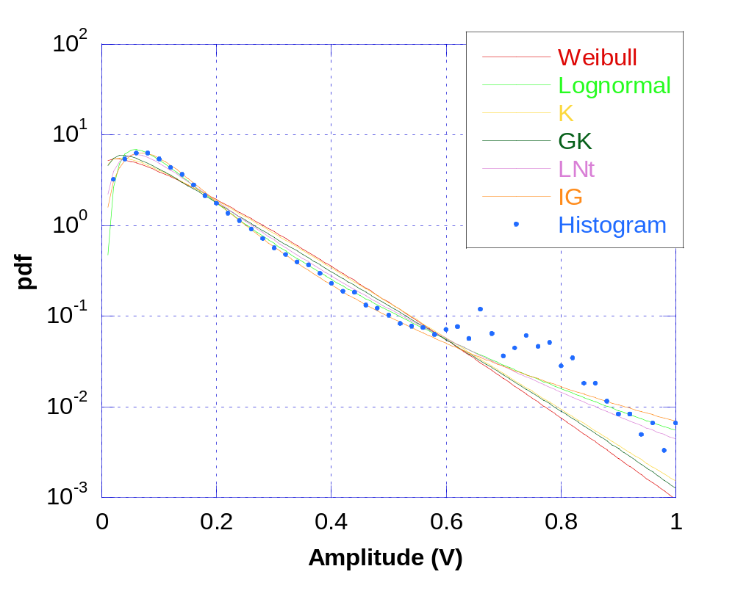
Empirically observed models
Empirical studies have produced several candidate models for the amplitude of spiky non-Gaussian clutter, the most popular being the Weibull distribution, the K distribution, the log-normal, the generalized Pareto, etc.
Measured sea clutter data
(IPIX database)
The APDF parameters have been obtained through the Method of Moments (MoM)
the Weibull , K,
log-normal, etc. have heavier tails than the Rayleigh
r

Slide 8
The multidimensional compound-Gaussian model
In practice, radars process m pulses at time, thus, to determine the optimal radar
processor we need the m-dimensional joint PDF
Since radar clutter is generally highly correlated, the joint PDF cannot be derived
by simply taking the product of the marginal PDFs
The appropriate multidimensional non-Gaussian model for use in radar detection
studies must incorporate the following features:
1) It must account for the measured first-order statistics (i.e., the APDF
should fit the experimental data)
2) It must incorporate pulse-to-pulse correlation between data samples
3) It must be chosen according to some criterion that clearly distinguishes
it from the multitude of multidimensional non-Gaussian models
satisfying 1) and 2)

Slide 9
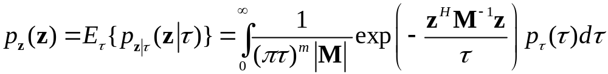
The multidimensional compound-Gaussian model
Conte and Longo [Con87] presented the idea of modelling the radar sea clutter
process as a spherically invariant random process (SIRP)
This idea leads to a multidimensional model of the clutter that includes
samples correlation and need not be Gaussian. By sampling a SIRP we obtain
a spherically invariant random vector (SIRV) whose PDF is given by
where z=[z₁ z₂ . . . z_{m}]^{T} is the m-dimensional complex vector representing
the observed data
A random process that gives rise to such a multidimensional PDF can be
physically interpreted in terms of a locally Gaussian process whose power
level τ is modulated because of the radar's large scale sampling of the environment
The PDF of the local power τ is determined by the fluctuation model of the number
N of scatterers

Slide 10


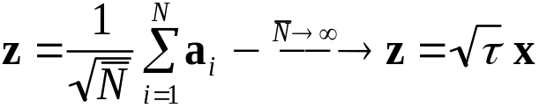
The multidimensional compound-Gaussian model
Yao’s representation theorem [Yao73]:
z is a SIRV
τ is a positive r.v. (texture)
x is a complex Gaussian vector (speckle)
compound-Gaussian model
Sangston and Gerlach [San92, San94] derived the same multidimensional PDF by
an extension of the CLT, so providing a different physical interpretation and
justification of this multivariate model:
{
a
}
i
.
i
.
d
.
,
E
{
a
}
=
0
,
E
{
a
a
H
}
=
M
i
i
i
i
From a physical point of view, the major assumption of this model, that allows
the extension to the multidimensional setting, is that during the time that the m
radar pulses are scattered, the number N of scatterers remains fixed
We obtain the K distribution if N is a negative binomial r.v. and the Gaussian
distribution if N is deterministic, Poisson, or binomial)

Slide 11
The multidimensional compound-Gaussian model
Many known APDFs belong to the SIRV family:
  Gaussian, Generalized Gaussian, Contaminated normal,
  Laplace, Generalized Laplace, Chauchy, Generalized Chauchy,
  K, Student-t, Chi, Generalized Rayleigh, Weibull, Rician,
  Nakagami-m. The log-normal can not be represented as a SIRV
for some of them p_{τ}(τ) is not known in closed form (see [Con95, Ran95])
The assumption that, during the time that the m radar pulses are scattered, the
number N of scatterers remains fixed, implies that the texture τ is constant during
the coherent processing interval (CPI), i.e., completely correlated texture
A more general model is given by
Extensions to describe the clutter process, instead of the clutter vector,
investigated the cyclostationary properties of the texture process τ[n]
(see [Gin01, Gin02, Gre04])

Slide 12

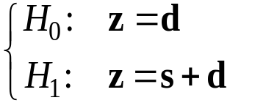


The detection problem: the radar transmits a coherent train of m pulses and the receiver properly demodulates, filters and samples the incoming narrowband waveform. The samples of the baseband complex signal (in-phase and quadrature components) are:
Observed data:
Binary hypothesis test:
d = disturbance vector
(clutter and/or thermal noise)
Target samples:
p is usually called “steering vector”
m
x1
per each range cell
s = target signal vector
  Perfectly known;
  Unknown:
    deterministic (unknown parameters, e.g., amplitude, initial phase, Doppler frequency, Doppler rate, DOA, etc.)
    random (rank-one waveform, multi-dimensional waveform)

Slide 13





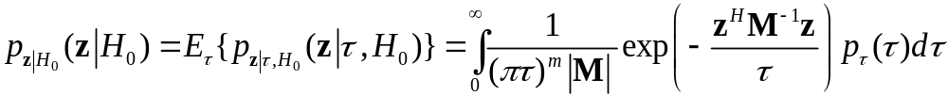
The compound-Gaussian clutter model
Clutter model for completely correlated texture: τ [n] =τ during the CPI
(coherent processing interval), the non-Gaussian clutter vector is a SIRV:
If the clutter is Gaussian:
Texture
Speckle
The PDF of z under the hypothesis H₀ is obtained by averaging the PDF of z|τ
with respect to τ

Slide 14
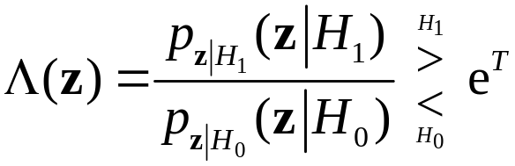
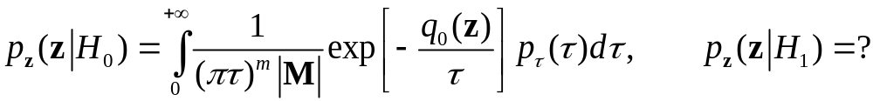

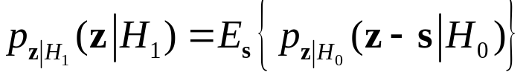

The optimum Neyman-Pearson detector
The optimum N-P detector is the LRT:
It depends on the target signal model:
Different models of s have been investigated
to take into account different degrees of a priori
knowledge on the target signal:
(1) s = perfectly known
(2) s=βp with β unknown deterministic and p perfectly known
(3) s=βp with , i.e., Swerling-I target model, and p perfectly known
(4) s=βp with and p unknown (known function of unknown parameters)
(5) s = Gaussian distributed random vector (known to belong to a subspace of dim. r<m)

Slide 15
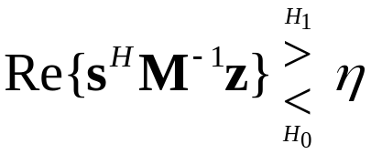
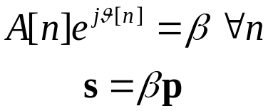



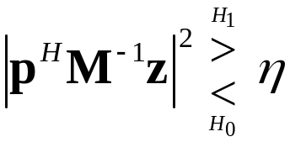
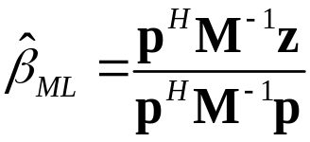
Coherent detection in Gaussian clutter: The Whitening Matched Filter (WMF)
Case 1) Perfectly known signal
Case 2) Constant
complex amplitude
(β unknown deterministic)
Case 3) Constant complex amplitude
(β random, Swerling-I)
Swerling-I:
The (coherent) whitening matched filter (WMF)
GLRT approach
(in this case a Uniformly Most Powerful (UMP) test does not exist)
typically:
LRT
is the maximum likelihood (ML) estimate of β
The (incoherent) whitening matched filter (WMF)

Slide 16



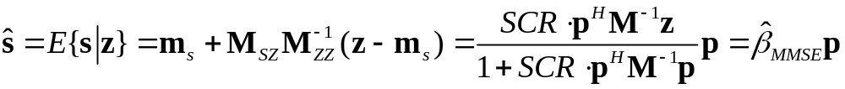
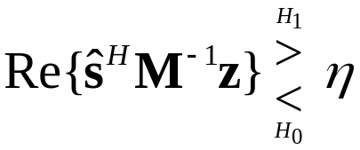
Alternative interpretation of the WMF: the Estimator-Correlator structure
The “estimator-correlator” interpretation for Swerling-I target signal:
SCR is the signal-to-clutter power ratio at the input of the WMF:
The mmse estimator of the target signal is given by:
The N-P detector for Gaussian random targets is obtained by replacing the unknown signal with its mmse estimate in the N-P detector for perfectly known signal
The N-P detector for perfectly known signal correlates the data with the known signal vector, weighted by the inverse of the
disturbance covariance matrix

Slide 17
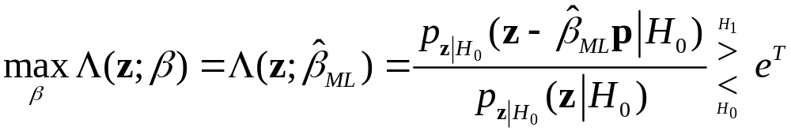

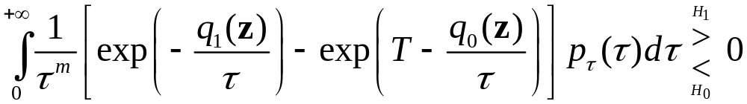
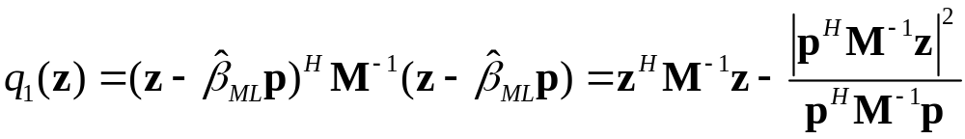

Coherent detection in compound-Gaussian clutter
Case 2). β unknown deterministic. A UMP test does not exist.
A suboptimal approach is the Generalized LRT (GLRT):
The test statistic is given by the LR for known β, in which the unknown parameter has been replaced by its maximum likelihood (ML) estimate
When the number m of integrated samples
increases ,
thus, we expect the GLRT performance to approach that of the
N-P detector for perfectly known signal
where

Slide 18
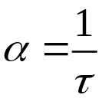
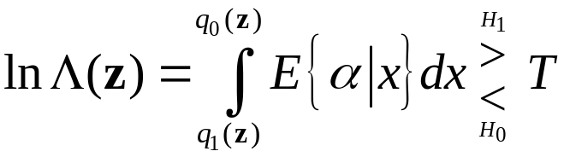

Alternative interpretation of the OD : the Estimator-Correlator
The N-P optimum detector (OD) and the GLRT are difficult to implement in the LRT
form, since it requires a computational heavy numerical integration!
The LRT does not give insight that might be used to develop good suboptimum
approximations to the OD and GLRT
To understand better the operation of the OD and GLRT, reparametrize the conditional
Gaussian PDF by setting:
The key to understanding the operation of the OD and GLRT is to express it as a function
of the mmse estimate of α :
α is the reciprocal of the local clutter power in the range cell under test (CUT)
mmse estimate of α under
the hypothesis H_{i} (i=0,1)
after Sangston: [San92], [San99].

Slide 19


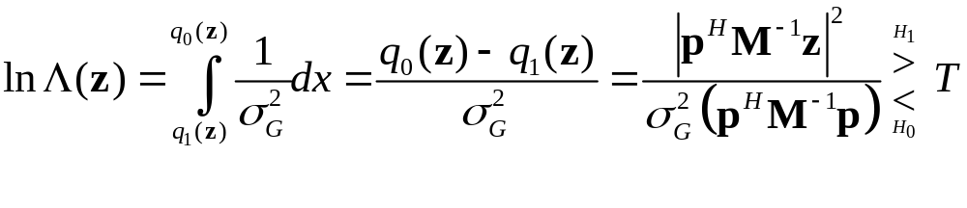

Alternative interpretation of the OD: the Estimator-Correlator
In Gaussian disturbance with power we have (deterministic quantity)
This structure is of the form of an estimator-correlator (Schwartz, IEEE-IT, 1975)
The structure of the OD in compound-Gaussian clutter is the basic detection structure
of the OD in Gaussian disturbance with the quantity , which is known in the
case of Gaussian noise, replaced by the mmse estimate of the unknown random α
The quantity to be estimated is not the local clutter power τ, but its inverse α =1/τ
This formulation is also difficult to implement, but it is very important because
it suggests that sub-optimum detectors may be obtained by replacing the optimum
mmse estimator with sub-optimum estimators that may be simpler to implement
(e.g., MAP or ML)

Slide 20
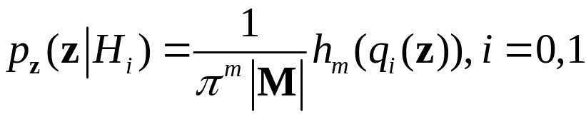
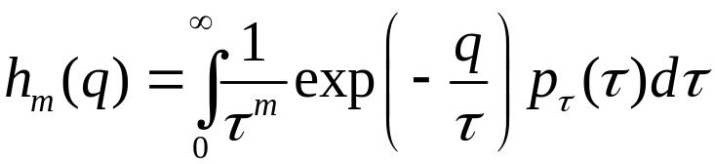
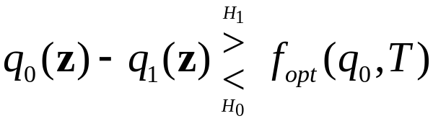

Alternative interpretation of the OD: the Data-Dependent Threshold
First step: express the PDFs under the two hypotheses as:
where h_{m}(q) is the nonlinear monotonic decreasing function:
The LRT can be recast in the form:
f_{opt}(q₀,T) is the data-dependent threshold, that depends on the data only by means of the quadratic statistic:

Slide 21
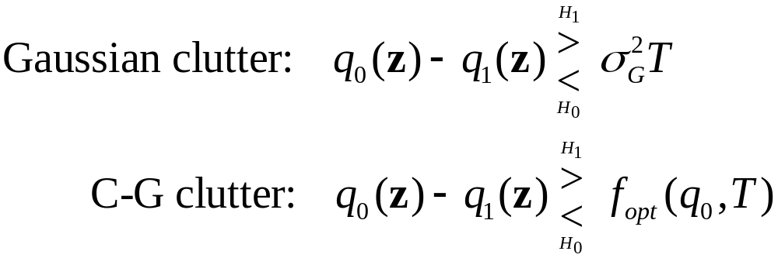
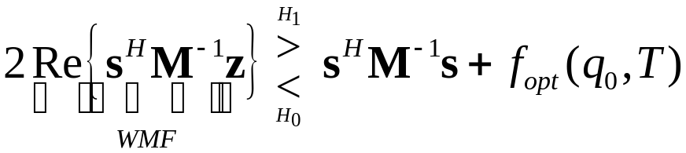
Alternative interpretation of the OD: the Data-Dependent Threshold
In this formulation the LRT for compound-Gaussian clutter has a similar structure of the LRT in Gaussian disturbance, with the significant difference that now the threshold of the test is not constant but it depends on the data through q₀
Perfectly known signal s (case 1): the OD can be interpreted as the classical whitening-matched filter (WMF) compared to a data-dependent threshold (DDT) [San99], [Gin99]

Slide 22
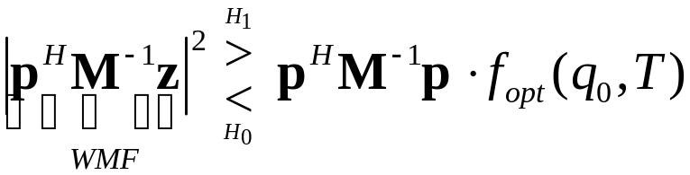
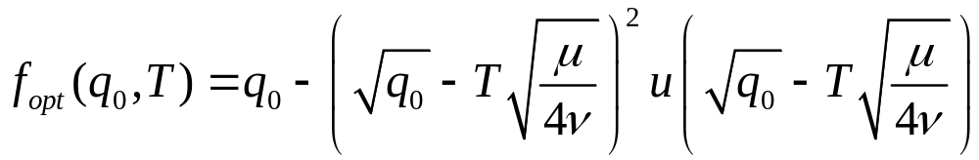
Alternative interpretation of the OD: the Data-Dependent Threshold
Signal s with unknown complex amplitude (Case 2): the GLRT again can be interpreted as the classical whitening-matched filter (WMF) compared to the same
data-dependent threshold (DDT)
Example: K-distributed clutter.
In this case the texture is modelled as a Gamma r.v. with mean value μ and order
parameter ν. For ν-m=0.5 we have:
In general, it is not possible to find a closed-form expression for the DDT, so it must be calculated numerically.

Slide 23
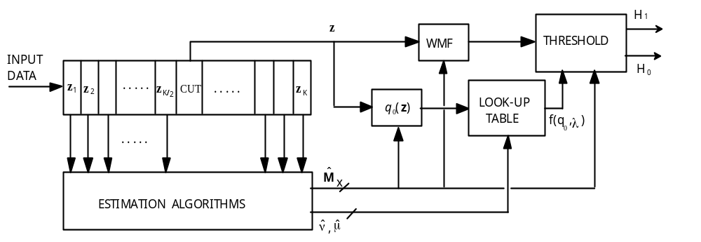
Canonical structure of the Optimum Detector
This canonical structure suggests a practical way to implement the OD and GLRT
The DDT can be a priori tabulated, with the threshold T set according to the prefixed
P_{FA}, and the generated look-up table saved in a memory
This approach is highly time-saving, it is canonical for every SIRV, and it is useful
both for practical implementation of the detector and for performance analysis
by means of Monte Carlo simulation
This formulation provides a deeper insight into the operation of the OD and GLRT,
and suggests another approach for deriving good suboptimum detectors

Slide 24
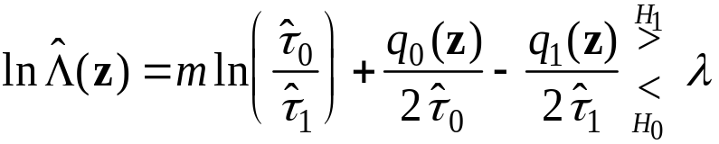

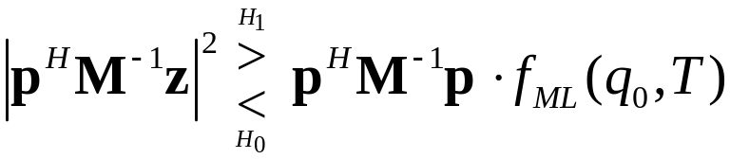
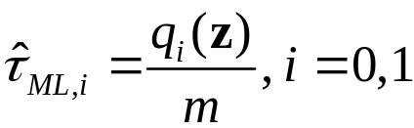

Suboptimum detection structures
Suboptimum approximations to the likelihood ratio test (LRT)
From a physical point of view, the difficulty in utilizing the LRT arises from the fact that the power level τ, associated with the conditionally Gaussian clutter is unknown and randomly varying: we have to resort to numerical integration
The idea is: replace the unknown power level τ with an estimate inside the LRT
Candidate estimation techniques:
MMSE, MAP, ML
The simplest is the ML
It has been called the GLRT-LQ (or NMF) [Gin97]
It is in the canonical form, with the adaptive threshold that is a linear function of q₀

Slide 25
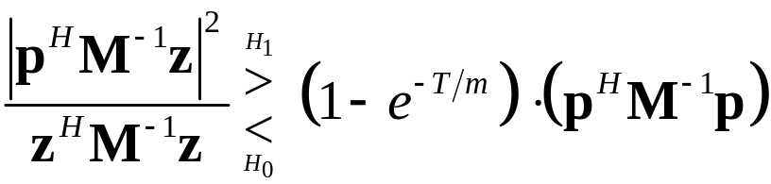
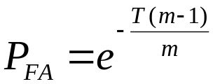
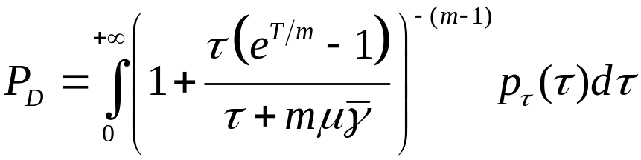
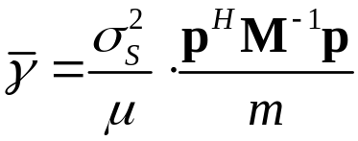

Suboptimum approximations to the Likelihood Ratio
The Linear-Quadratic GLRT (GLRT-LQ), also called the Normalized Matched Filter (NMF)
This detector is very simple to
implement
It has the constant false alarm rate
(CFAR) property with respect to
the clutter PDF
The same decision strategy was
also obtained, under different
assumptions, by Korado [Kor68],
Picinbono and Vezzosi [Pic70],
Scharf and Lytle [Sch71],
Conte et al. [Con95].
is the SCR at the output of the WMF, divided by m

Slide 26
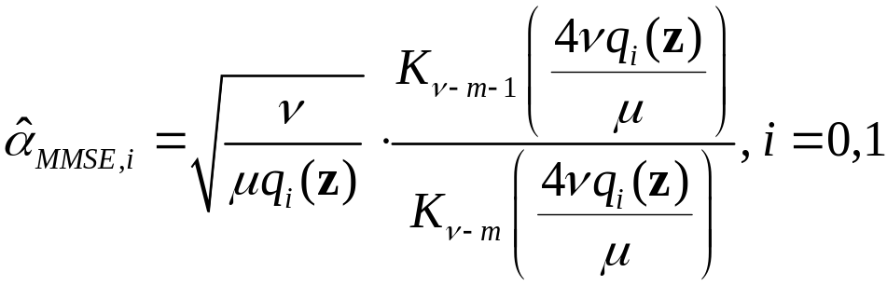
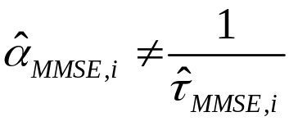
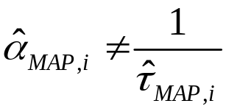
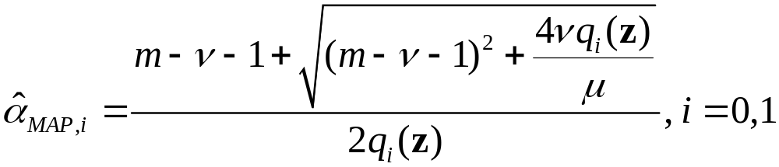
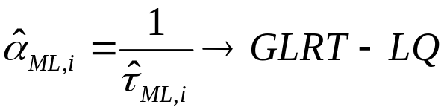
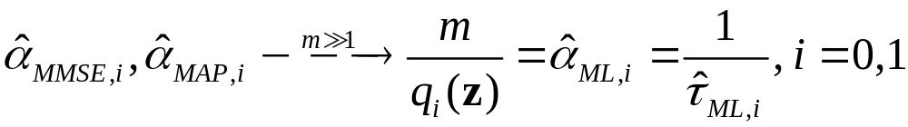
Suboptimum approximations to the Estimator-Correlator structure
The mmse estimator of α=1/τ may be difficult to implement in a practical detector.
e.g. for K-distributed clutter:
Suboptimum detectors may be obtained by replacing the mmse estimator with
a suboptimal estimator (e.g., MAP or ML):
As the number m of samples becomes asymptotic large, the GLRT-LQ becomes equivalent
to the OD:

Slide 27
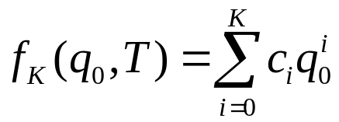
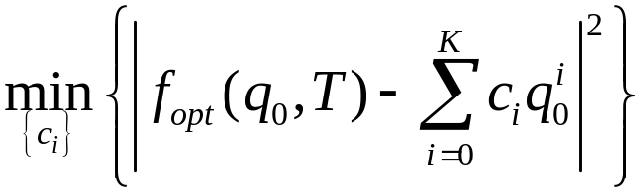
Suboptimum approximations to the Data-Dependent Threshold structure
The canonical structure in the form of a WMF
compared to a data dependent threshold is given by:
the threshold f_{opt}(q₀,Τ ) depends in a complicated
nonlinear fashion on the quadratic statistic q₀(z)
The idea is to find a good approximation of f_{opt}(q₀,Τ ) that is easy to implement.
In this way, we avoid the need of saving a look-up table in the receiver memory
The approximation has to be good only for values of q₀(z) that have a high
probability of occurrence
We looked for the best K-th order polynomial approximation in the MMSE sense:
f_{K}(q₀,Τ ) is easy to compute from q₀(z)

Slide 28
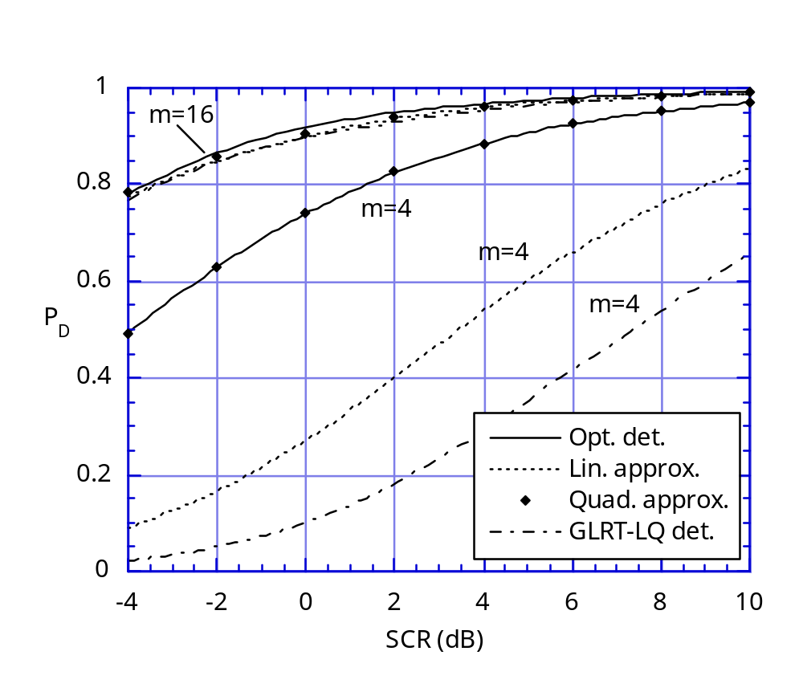
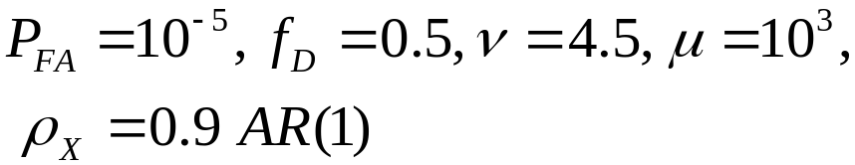
Performance Analysis: Swerling-I target, K-distributed clutter
In all the cases we examined, the suboptimum detector based on the quadratic (2nd-order)
approximation has performance (i.e., P_{D}) almost indistinguishable from the optimal
The detector based on 2nd-order
approximation represents a good
trade-off between performance and
computational complexity
It requires knowledge of the clutter
APDF parameters (ν and μ)
As the number m of integrated
pulses increases, the detection
performance of the GLRT-LQ
approaches the optimal performance
The GLRT-LQ does not require
knowledge of ν and μ
It is CFAR w.r.t. texture PDF

Slide 29
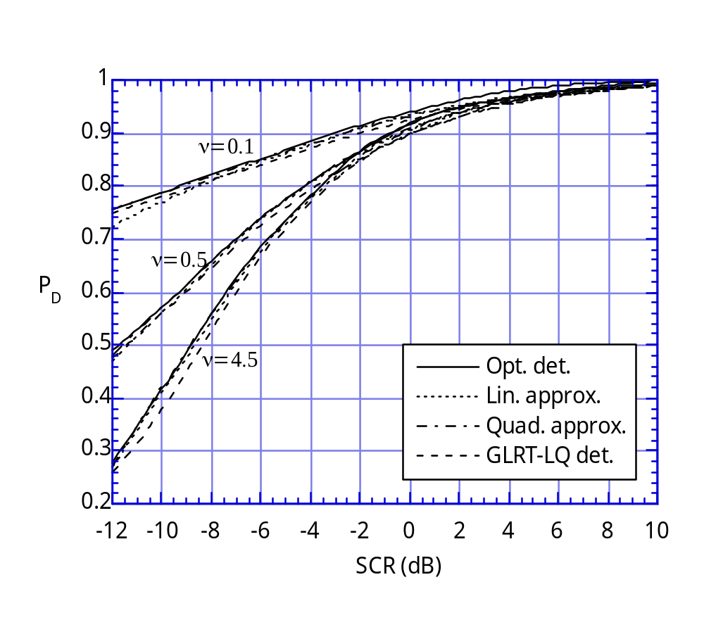
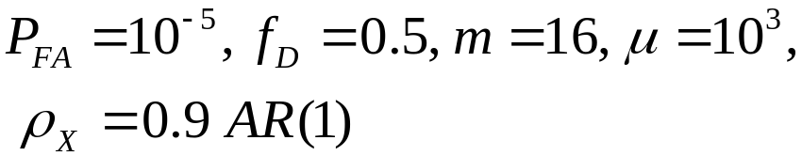
Performance Analysis: Swerling-I target, K-distributed clutter
Swerling-I target: it was observed that in this case, P_{D} increases much more
slowly as a function of SCR than for the case of known target signal
Clutter spikiness heavily affects
detection performance
ν=0.1 means very spiky clutter
(heavy tailed)
ν=4.5 means almost Gaussian clutter
Up to high values of SCR, the best
detection performance is obtained
for spiky clutter (small values of ν),
i.e., it is more difficult to detect weak
targets in Gaussian clutter rather
than in spiky K-distributed clutter,
(provided that the optimal decision
strategy is adopted!)

Slide 30





Performance Analysis: Swerling-I target, K-distributed clutter
Optimum Detector in K-clutter (OKD)
Optimum Detector in Gaussian clutter (OGD) = Whitening Matched Filter (WMF)
This figure shows how a wrong assumption on clutter model (model mismatching) affects detection performance

Slide 31



Performance Analysis: Swerling-I, K-distributed clutter, real sea clutter data
The gain of the GLRT-LQ over the
mismatched OGD increases with
clutter spikiness (decreasing values of ν)
Performance prediction have been
checked with real sea clutter data
The detectors make use of the
knowledge of μ, ν, and M
(obtained from the entire set of data)
m=16
m=16

Slide 32

Coherent radar detection in non-Gaussian clutter: Summary of the Results
We have examined the problem of optimal and sub-optimal target detection in Gaussian clutter and non-Gaussian clutter modelled by the compound-Gaussian distribution
Three interpretations of the optimum detector (OD) have been provided:
  the likelihood ratio test (LRT),
  the estimator-correlator (EC),
  the whitening matched filter (WMF) and data-dependent threshold.
With these reformulations of the OD, the problem of obtaining sub-optimal detectors may be approached by either:
(i) approximating the LRT directly, utilizing an estimate of τ
(ii) utilizing a sub-optimal estimate of α in the estimator-correlator structure,
(iii) utilizing a sub-optimal function to model the data-dependent threshold
in the WMF interpretation.
Numerical results suggest that the GLRT-LQ [(i),(ii)] and the sub-optimal detector based on quadratic approximation of the data-dependent threshold [(iii)] represent the best trade-off between implementation complexity and detection performance

Slide 33



The Data-Dependent Threshold structure: New results
The LRT can be recast in the form:
f_{opt}(q₀,T) is the data-dependent threshold, that depends on the data only by means of the quadratic statistic:
The left-hand term depends on the target signal model
h_{m}(q) is a nonlinear monotonic decreasing function, which depends on the texture PDF:
Reparametrize in terms of the inverse of the local clutter power:

Slide 34

The Linear-Threshold Detector
The simplest extension beyond the Gaussian case would appear to be a linear form for f_{opt}(q₀,T):
we will call a detector whit this form of the DDT: a linear-threshold detector (LTD).
The LTD was originally explored in [San99] as an approximation to f_{opt}(q₀,T): for the case of K-distributed compound-Gaussian clutter, and then further investigated in [Gin99] and [Gin02]. Now, we ask a much different question about the LTD:
Is there a compound-Gaussian model for which the linear-threshold detector is the optimum detector?

Slide 35



The Linear-Threshold Detector
If the answer is yes, the multivariate compound-Gaussian clutter model, which is defined through the function h_{m}(q₀) must satisfy:
This problem can be reformulated as an Abel problem, which has a unique solution.
The solution provides a Gamma PDF for α and as a consequence the texture τ has an inverse-Gamma PDF:
λ>0 is the shape parameter and η>0 is the scale parameter.
Consequently, the complex multivariate compound-Gaussian clutter model is a complex m-variate t distribution with degrees of freedom λ :

Slide 36



The Linear-Threshold Detector
The optimum detector in compound-Gaussian clutter with IG texture is given by:

Slide 37


The clutter amplitude model
The clutter amplitude PDF that arises from the compound-Gaussian clutter model with IG texture:
Interestingly, the PDF of the clutter intensity, W=R², is a generalized Pareto distribution
the clutter amplitude statistics are extremely heavy-tailed in this limit

Slide 38




The clutter amplitude model
Thus the multivariate clutter model with IG texture varies parametrically
between Gaussian clutter (when λ goes to infinity) and extremely
heavy-tailed clutter (when λ goes to zero)
The clutter power
is finite only for λ>1

Slide 39


Implications of the optimum detector
When the shape parameter λ goes to zero:
which is the GLRT-LQ (or NMF) detector previously explored [Gin97], known to be the optimal detector as m goes to infinity [Con95] and also known to be a CFAR detector.
The remarkable observation here is that
the GLRT-LQ is the optimum detector for any m
for the CG clutter model with IG texture,
in the limit of extremely heavy-tailed clutter, i.e. as λ goes to 0

Slide 40




The GLRT-LTD and its Performance
When the complex amplitude is deterministic unknown and we resort to the GLRT approach (i.e. we replace β with its ML estimate in the LRT):

Slide 41


The GLRT-LTD and its Performance
Thus, for large m, the GLRT-LDT detector is in practice CFAR with respect to both λ and η
(the texture parameters)

Slide 42


The GLRT-LTD and its Performance
In heavy-tailed clutter:
the GLRT-LTD largely outperforms the (mismatched) WMF
The False Alarm Rate (FAR) increases when the clutter becomes spikier (lower λ)

Slide 43

The GLRT-LTD and its Performance
Detection performance of the GLRT-LTD gets better when the clutter becomes spikier
When the number of pulses is large (say m>10), the GLRT-LQ and the optimal GLRT-LTD have almost the same performance

Slide 44
Concluding Remarks
Based on the interpretation of the optimum detector (OD) as a whitening matched filter (WMF) compared to a data-dependent threshold (DDT), we have derived a compound-Gaussian (CG) clutter model whose OD is the optimum Gaussian WMF compared to a DDT that varies linearly with q₀(z)
The CG clutter model with inverse Gamma (IG) texture varies parametrically from the Gaussian clutter model to a clutter model whose tails are evidently heavier than any K model
The GLRT-LQ, which is a popular suboptimum detector due to its CFAR property, is an OD for the CG clutter model with IG texture, in the limit as the tails get extremely heavy (small λ), and the OD for any CG model for large m
The LTD is conceptually the simplest extension beyond the optimum Gaussian detector (constant threshold). Although a quadratic-threshold detector may be obtained [Gin99], such a detector will always be suboptimum for any compound-Gaussian model

